Slide 1
Smart Home Simulation with Arduino and Tinkercad
CEIS101 Final Course Project
April 2025 / CEIS101
Timothy Wheels
Prof. John Lambrou

Slide 2
Introduction
This Arduino-based project was designed to simulate a smart home automation and security system using Tinkercad’s virtual emulator. The system included a combination of sensors and LED indicators to monitor conditions such as door status, proximity to intruders, and ambient lighting. Through this simulation, I was able to explore how real-world smart devices operate in response to environmental changes.
The main objective was to build and program a virtual prototype that demonstrates core smart home functions. These functions include detecting whether a door is open or closed, using a distance sensor to monitor for intruders, and automating lights based on brightness levels. Additional features such as flood detection and environmental monitoring were also explored.

Slide 3
CEIS101 Module 2
Circuit Simulation in Tinkercad

Slide 4
Circuit (screenshot)

Slide 5
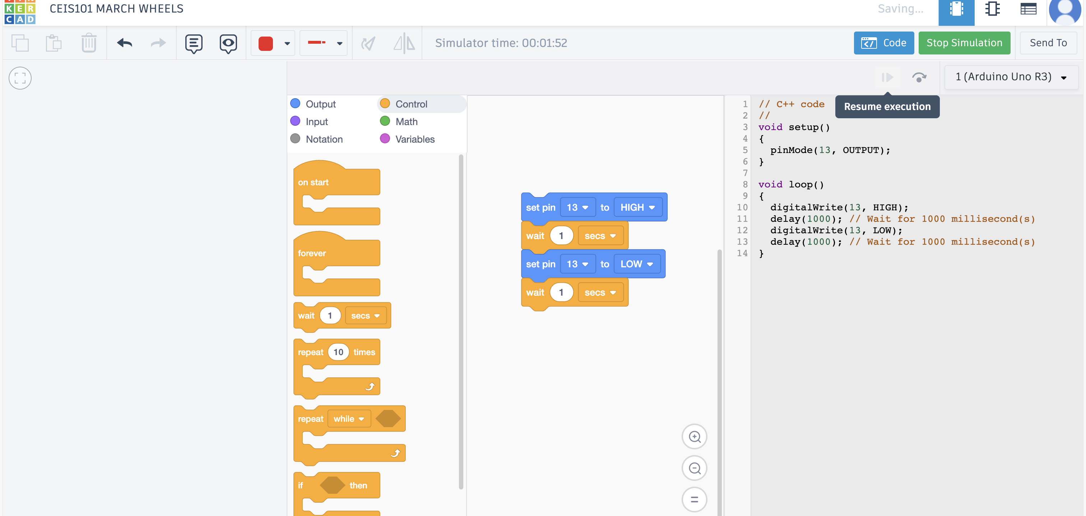

Slide 6
The objective of this activity was to design, build, and simulate a functional Arduino-based circuit using Tinkercad. The project required constructing the virtual circuit layout by connecting components such as an Arduino Uno board, breadboard, resistors, and LEDs (or other components depending on the task), followed by writing and uploading code to control the behavior of the circuit.
Using Tinkercad’s simulation environment, I was able to test and verify the accuracy of my circuit design and Arduino program. This activity strengthened my understanding of basic electronics, digital logic, and microcontroller programming. It also gave me hands-on experience in prototyping with Arduino and reinforced concepts such as pin configuration, loops, conditionals, and digital input/output operations.

Slide 7
CEIS101 Module 3
Inventory of Parts, Circuit Building, and Displaying Messages

Slide 8
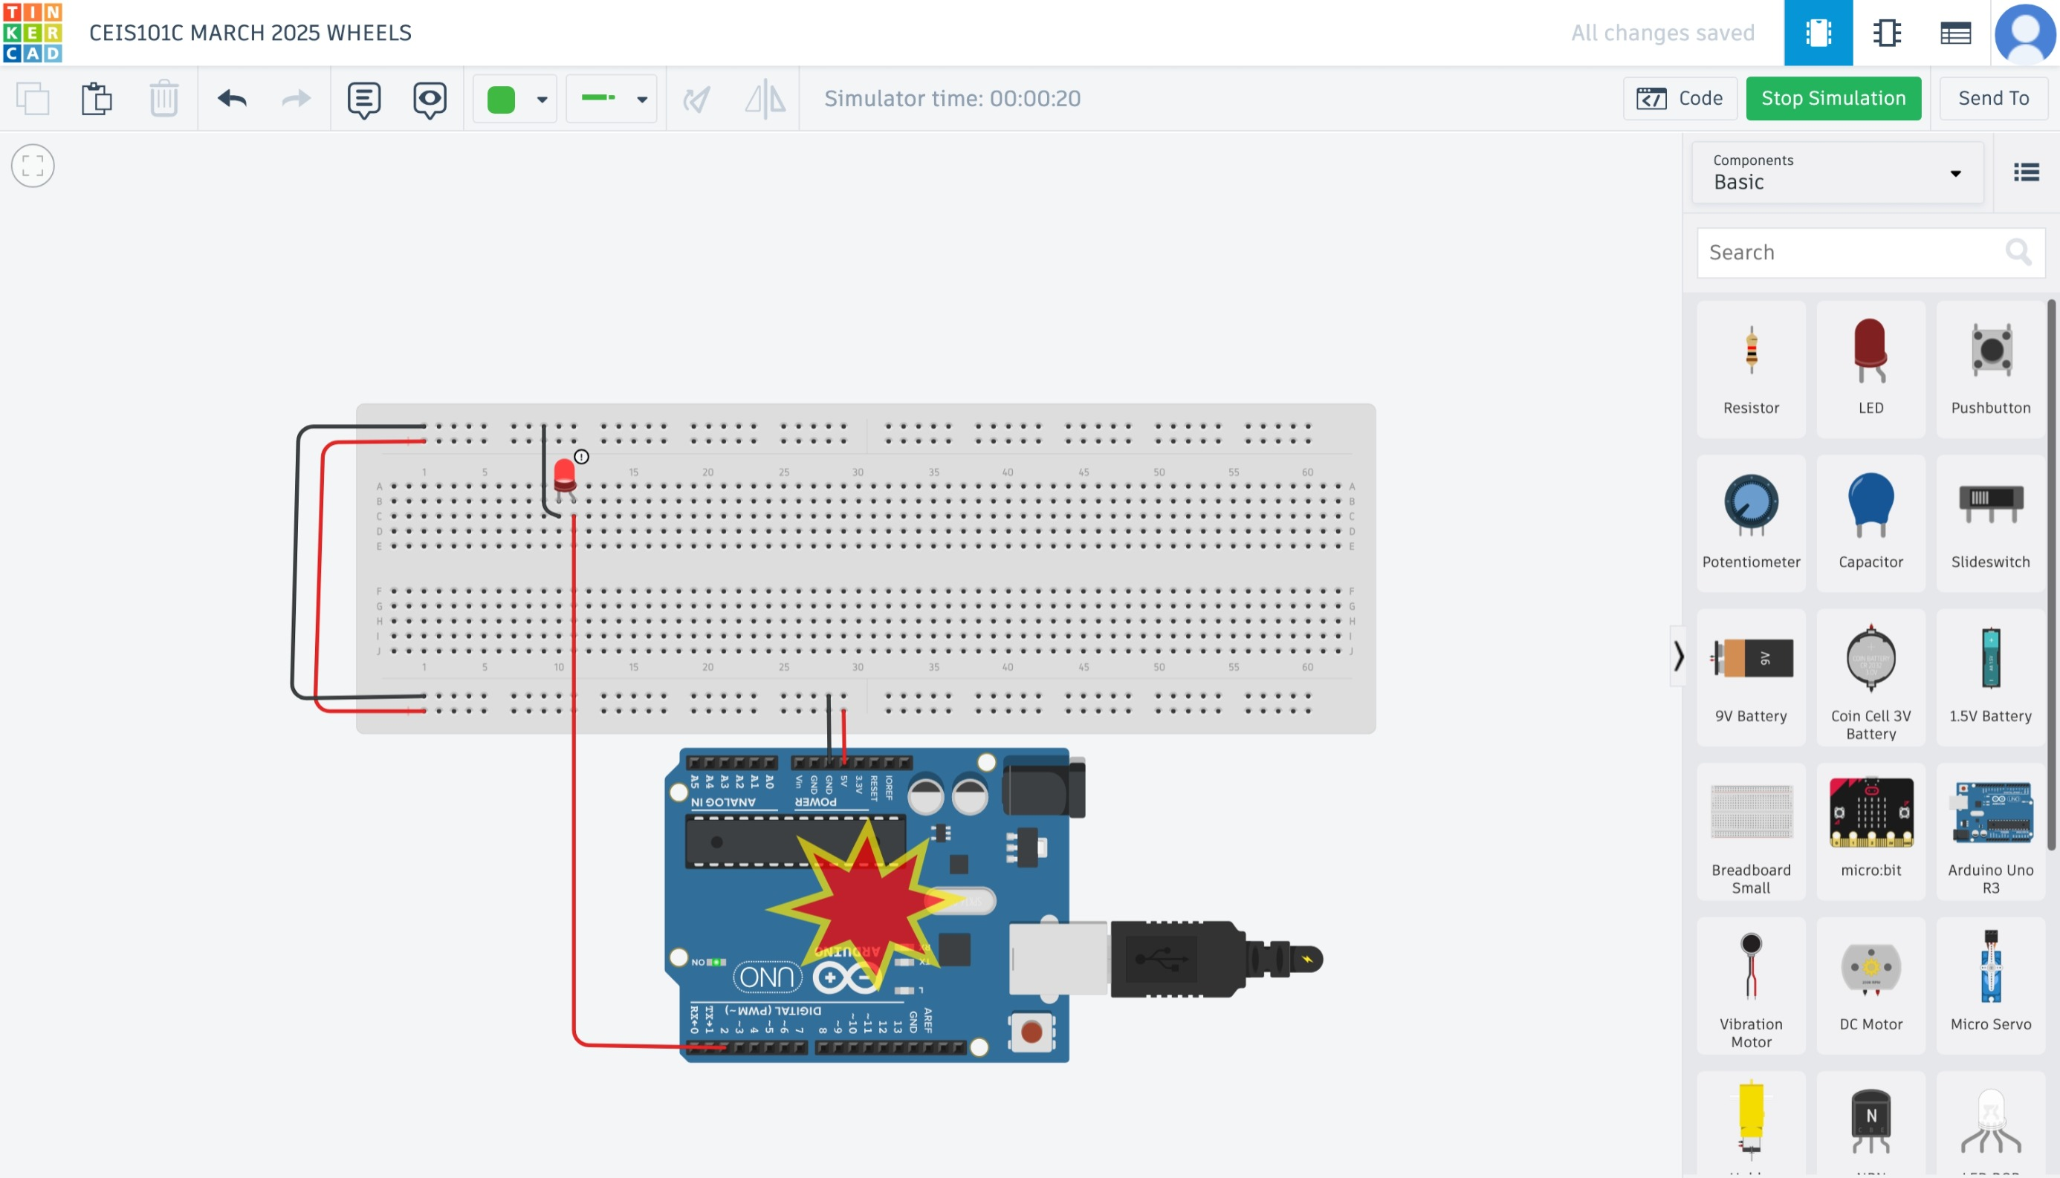

Slide 9
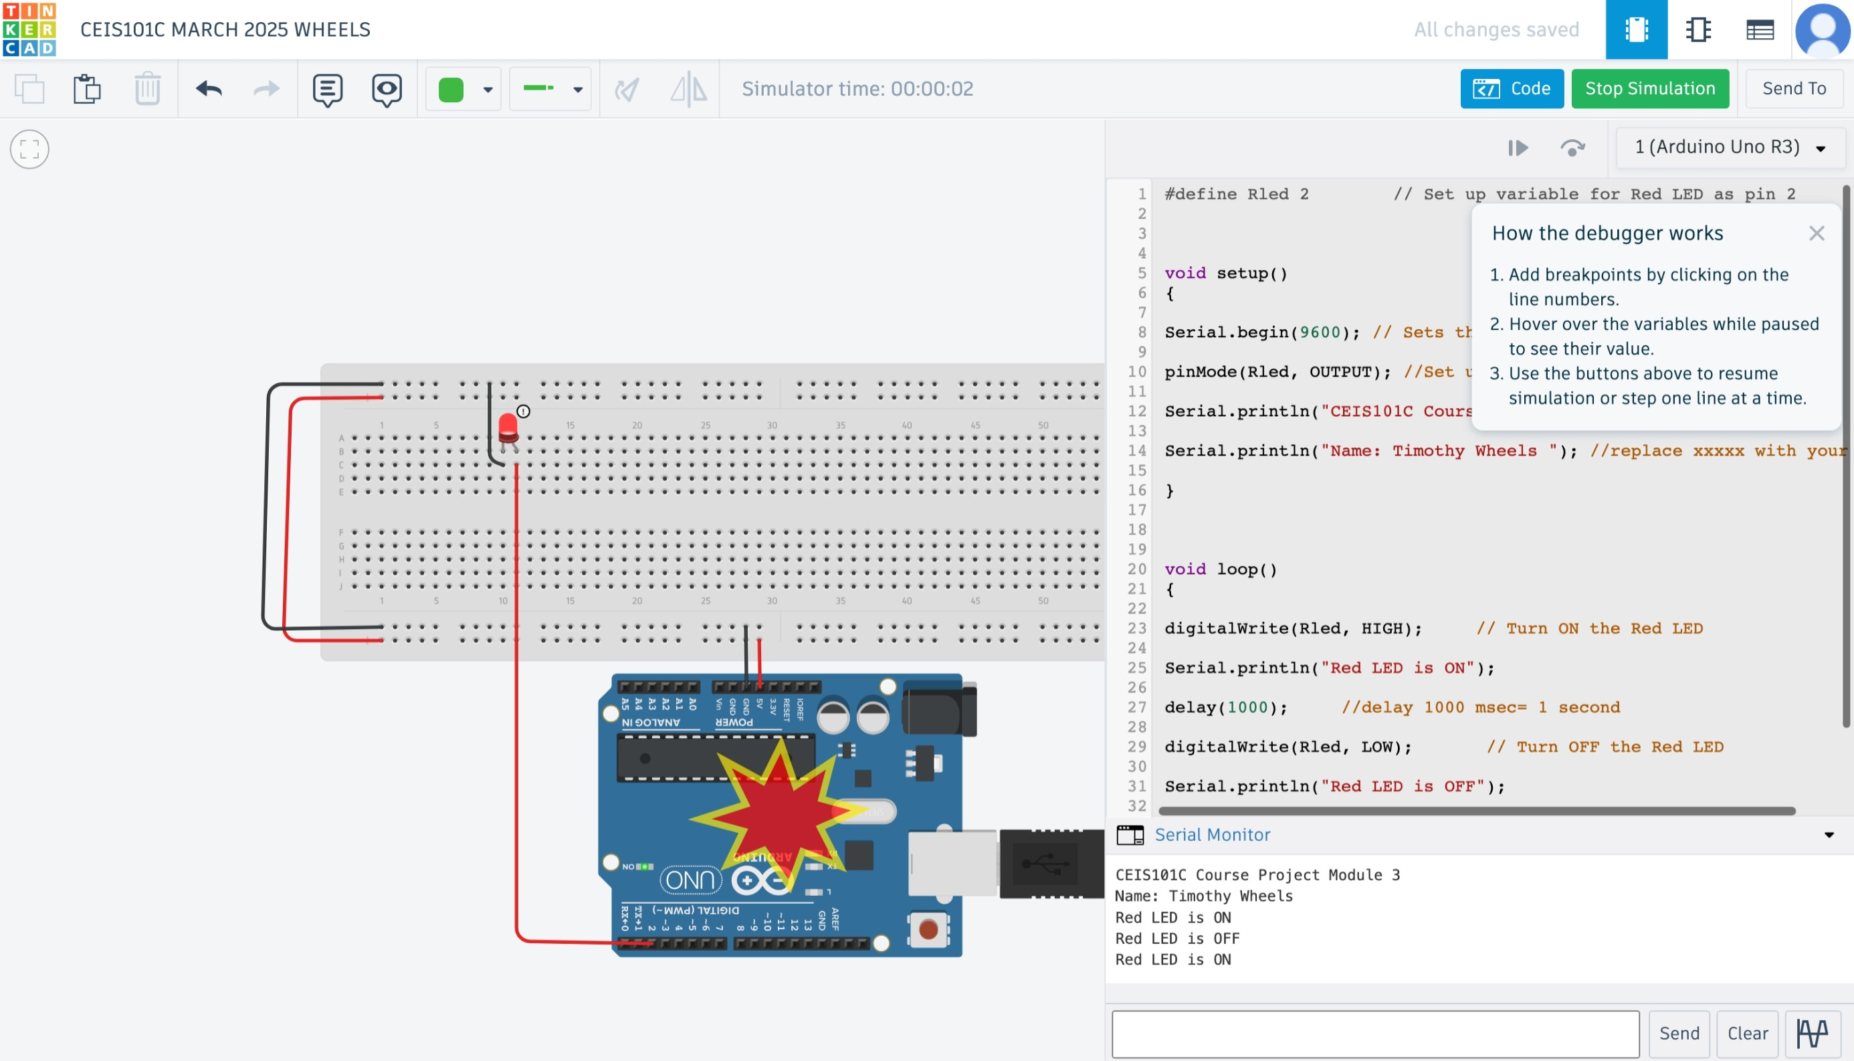

Slide 10
The objective of this activity was to design and prototype a smart home automation and security system using Arduino components and Tinkercad’s virtual emulator. The system incorporated multiple sensors and outputs to simulate real-world home monitoring features. These included a door sensor to detect open/closed status, a distance sensor to monitor for potential intruders, and a light sensor to automate lighting when dark. Optional components like water level and temperature/humidity sensors could be added to enhance the system’s responsiveness to environmental conditions.
In Module 3 specifically, the focus was on building circuits with LEDs and learning how to control them through programming. This included initializing and using the Arduino’s Serial Monitor to display messages and system statuses. Through this exercise, I became more familiar with key hardware components, practiced digital output control, and developed foundational skills for integrating interactive elements into the broader smart home system.

Slide 11
CEIS101 Module 4
Adding Door Sensor to Smart Home System

Slide 12
Circuit of door closed with Green LED ON (picture)

Slide 13
Circuit of door open with Green LED OFF (picture)

Slide 14
Arduino Code (screenshot)

Slide 15
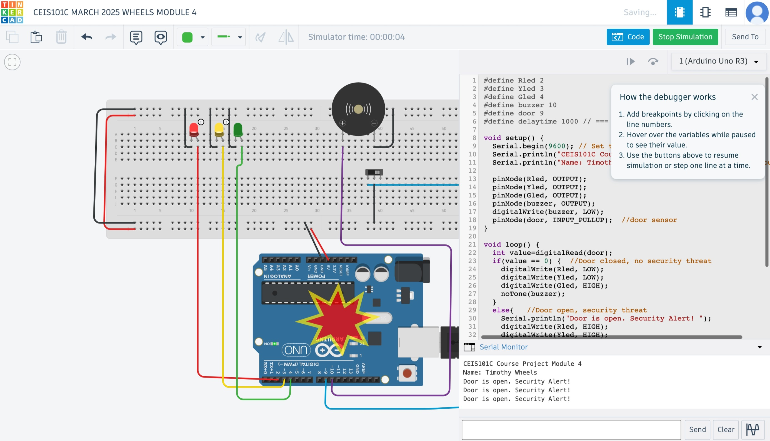
Serial Monitor (screenshot)

Slide 16
The objective of this activity was to simulate a basic smart home door monitoring system using Tinkercad and an Arduino board. The project involved setting up a virtual circuit to visually represent the status of a door using LEDs. A green LED indicated the door was closed, while red and yellow LEDs activated when the door was open.
I built two versions of the circuit: one showing the green LED lit (door closed), and one showing the red and yellow LEDs lit (door open). I uploaded and tested a custom Arduino sketch using the Arduino IDE, which included personalized messages displayed through the Serial Monitor. This ensured the code was working as intended and helped simulate real-time system feedback. Screenshots were captured at each step, including the working circuit states, Arduino code with my name displayed, and the Serial Monitor output showing status messages with my name.
This exercise reinforced my understanding of digital outputs, condition-based programming, and using the Serial Monitor for system communication—key foundational skills in embedded systems and home automation.

Slide 17
CEIS101 Module 5
Adding Distance Sensor to Smart Home System
and Conducting Data Analysis

Slide 18
Circuit with green LED on (picture)

Slide 19
Circuit with yellow LED on (picture)

Slide 20
Circuit with red LED on (picture)

Slide 21
Arduino Code (screenshot)

Slide 22
Plot of data (graph from Excel)

Slide 23
CEIS101 Module 6
Adding Automated Light to Smart Home System

Slide 24
The objective of this activity was to build and program an Arduino-based system that uses a distance sensor to trigger different LED indicators depending on object proximity. Using Tinkercad’s virtual environment, I created a circuit that included an ultrasonic distance sensor and three LEDs—green, yellow, and red—to represent different distance thresholds.
As part of the simulation:
The green LED illuminated when the object was at a safe distance,
The yellow LED activated at a moderate range,
The red LED turned on when the object was too close.
I uploaded a custom Arduino sketch that controlled the LED behavior based on real-time distance data, with my name included in the code for identification. The system was then analyzed by collecting distance readings from the Serial Monitor and exporting the data to Excel. From this dataset, I created a plot to visualize the sensor readings over time, providing insight into how the LEDs responded to varying distances.
This activity helped reinforce conditional logic, sensor integration, serial communication, and basic data analysis—all key skills in developing interactive embedded systems.

Slide 25
Circuit with automated LED off (picture)

Slide 26
Circuit with automated LED on (picture)

Slide 27
Arduino Code (screenshot)

Slide 28
Serial Monitor (screenshot)

Slide 29
The objective of this activity was to build and program an Arduino-based system that uses a distance sensor to trigger different LED indicators depending on object proximity. Using Tinkercad’s virtual environment, I created a circuit that included an ultrasonic distance sensor and three LEDs—green, yellow, and red—to represent different distance thresholds.
As part of the simulation:
The green LED illuminated when the object was at a safe distance,
The yellow LED activated at a moderate range,
The red LED turned on when the object was too close.
I uploaded a custom Arduino sketch that controlled the LED behavior based on real-time distance data, with my name included in the code for identification. The system was then analyzed by collecting distance readings from the Serial Monitor and exporting the data to Excel. From this dataset, I created a plot to visualize the sensor readings over time, providing insight into how the LEDs responded to varying distances.
This activity helped reinforce conditional logic, sensor integration, serial communication, and basic data analysis—all key skills in developing interactive embedded systems.

Slide 30
References Page
Autodesk. (n.d.). Tinkercad Circuits: Learn and simulate Arduino projects online. Retrieved April 26, 2025, from https://www.tinkercad.com/learn/circuits
Arduino. (n.d.). LEDs and blink examples. Retrieved April 26, 2025, from https://www.arduino.cc/en/Tutorial/BuiltInExamples/Blink
Arduino. (n.d.). Using the HC-SR04 Ultrasonic Distance Sensor with Arduino. Retrieved April 26, 2025, from https://www.arduino.cc/en/Tutorial/UltrasoundSensor
MertArduino. (2018). How to use an ultrasonic sensor with Arduino. Instructables. https://www.instructables.com/Ultrasonic-Sensor-With-Arduino-Tutorial/
SparkFun Electronics. (n.d.). Serial communication and the Serial Monitor. Retrieved April 26, 2025, from https://learn.sparkfun.com/tutorials/serial-communication
Microsoft. (n.d.). Create a chart from start to finish. Microsoft Excel Help. Retrieved April 26, 2025, from https://support.microsoft.com/en-us/excel

Slide 31
Challenges/Lessons Learned
While working on this project, I encountered several common challenges. Wiring the virtual breadboard correctly was tricky at first—just one misplaced jumper wire caused errors in the circuit. I overcame this by carefully double-checking diagrams and testing each component step by step.
Debugging my Arduino code was also a major challenge. Small syntax issues and logic errors in my if statements caused the LEDs and sensors to behave unpredictably. I used the Serial Monitor to troubleshoot in real time and commented my code clearly to keep things organized.
Another challenge was interpreting sensor data accurately, especially with the distance sensor. I had to experiment with different threshold values and refer to similar projects online to get my LEDs to respond correctly.
Through this process, I learned the importance of attention to detail, logical thinking, and persistence. I gained confidence using microcontrollers and programming tools, and now feel better equipped to build and troubleshoot embedded systems in future projects.

Slide 32
Career Skills
By completing this project, I developed foundational skills that will benefit me as I grow in my programming and tech career. I learned how to build and simulate circuits using Arduino, which gave me hands-on experience with hardware and electronics. Writing and debugging code helped me understand basic programming logic and how to use conditionals and loops to control components based on sensor data.
I also strengthened my problem-solving skills by using the Serial Monitor to troubleshoot issues, which taught me to be patient and think critically. Collecting and analyzing sensor data gave me a better understanding of how real-time systems work and how to interpret technical information.
Overall, this project taught me the importance of attention to detail, thinking logically, and staying persistent when things don’t work right the first time. These skills—and the confidence I’ve gained—will help me in future courses, job opportunities, and any career path that involves technology, programming, or smart systems.

Slide 33
Conclusion
This project was more than just a classroom assignment—it was a hands-on experience that challenged me to think like a real developer. I learned how to connect hardware, write efficient code, and solve problems step by step. From wiring LEDs to debugging with the Serial Monitor, every part of the process helped me grow as a student and as a future tech professional.
Most importantly, I’ve gained confidence in my ability to take on complex tasks, break them down, and find solutions. I’m proud of how far I’ve come, and I look forward to applying these skills in future projects, both in school and in my career. This is just the beginning—and I’m ready for what’s next.

Slide 34
References
Autodesk. (n.d.). Tinkercad Circuits: Learn and simulate Arduino projects online. Retrieved April 26, 2025, from https://www.tinkercad.com/learn/circuits
Arduino. (n.d.). LEDs and blink examples. Retrieved April 26, 2025, from https://www.arduino.cc/en/Tutorial/BuiltInExamples/Blink
Arduino. (n.d.). Using the HC-SR04 Ultrasonic Distance Sensor with Arduino. Retrieved April 26, 2025, from https://www.arduino.cc/en/Tutorial/UltrasoundSensor
MertArduino. (2018). How to use an ultrasonic sensor with Arduino. Instructables. https://www.instructables.com/Ultrasonic-Sensor-With-Arduino-Tutorial/

Slide 35
References
Autodesk. (n.d.). Tinkercad Circuits: Learn and simulate Arduino projects online. Retrieved April 26, 2025, from https://www.tinkercad.com/learn/circuits
Arduino. (n.d.). LEDs and blink examples. Retrieved April 26, 2025, from https://www.arduino.cc/en/Tutorial/BuiltInExamples/Blink
Arduino. (n.d.). Using the HC-SR04 Ultrasonic Distance Sensor with Arduino. Retrieved April 26, 2025, from https://www.arduino.cc/en/Tutorial/UltrasoundSensor
MertArduino. (2018). How to use an ultrasonic sensor with Arduino. Instructables. https://www.instructables.com/Ultrasonic-Sensor-With-Arduino-Tutorial/
SparkFun Electronics. (n.d.). Serial communication and the Serial Monitor. Retrieved April 26, 2025, from https://learn.sparkfun.com/tutorials/serial-communication
Microsoft. (n.d.). Create a chart from start to finish. Microsoft Excel Help. Retrieved April 26, 2025, from https://support.microsoft.com/en-us/excel

